Slide 1
PHYSICAL THEATRE
Year 7 Drama
Lesson 6
Assessment

Slide 2
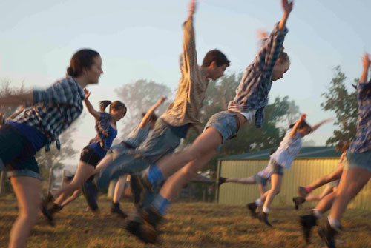
LESSON OBJECTIVE:
To create a performance piece using all of the skills learned previously

Slide 3
KEYWORDS
Lesson Objective:
To create a performance piece using all of the skills learned previously
To perform using physical theatre techniques
Physicalisation
Characterisation
Exaggeration
Non-naturalism

Slide 4
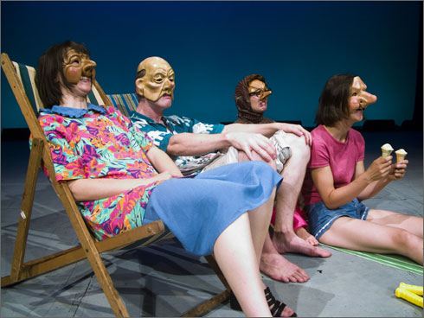
REGISTER SKILLS
Lesson Objective:
To create a performance piece using all of the skills learned previously
To perform using physical theatre techniques
When students answer the register, they have to answer stating a skill that is needed to make physical theatre effective

Slide 5
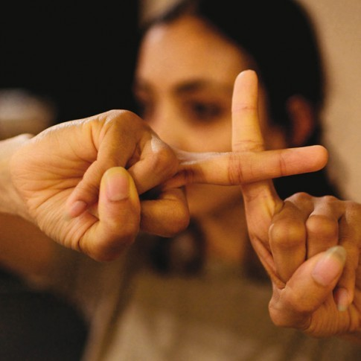
TASK
Lesson Objective:
To create a performance piece using all of the skills learned previously
To perform using physical theatre techniques
In today's lesson you will be assessed on the creating and performing process
Teacher will place students into pre-selected groups.
Each group has an envelope, which contains your task.
Students are to read as a group, taking note of the skills that they must use in their piece.

Slide 6
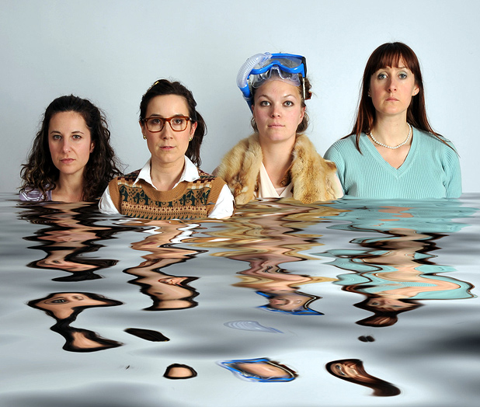
DISCUSSION TIME
Lesson Objective:
To create a performance piece using all of the skills learned previously
To perform using physical theatre techniques
Students must sit down in their groups and discuss which part everyone is going to play.
All students must try to contribute some ideas.
One student may be elected the Director or it can be a group effort.

Slide 7
REHEARSING
Lesson Objective:
To create a performance piece using all of the skills learned previously
To perform using physical theatre techniques
Students must work together to create their piece, with one student being allocated as the director if you have decided this previously.
Remember that actions and facial expressions need to be really exaggerated and the ideas can be abstract/unusual.
EXTENSION
Students must add an alternative ending to their story if they think they have finished ahead of time.

Slide 8
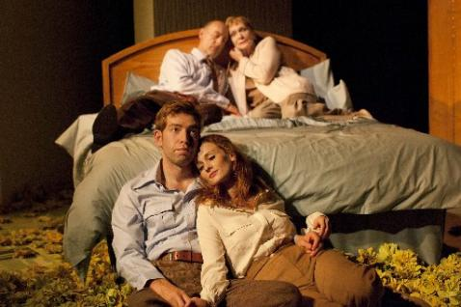
PERFORMANCE
Lesson Objective:
To create a performance piece using all of the skills learned previously
To perform using physical theatre techniques
Each group performs to the rest of the group and give feedback.

